Slide 1
What makes Python AWESOME?
Daniel Greenfeld

Slide 2
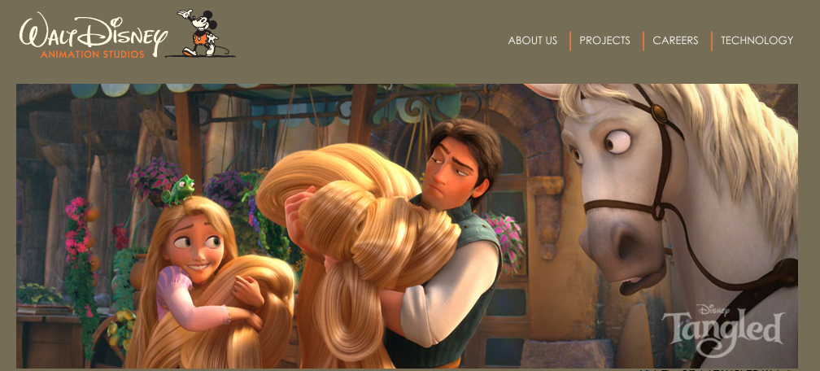
Disney!

Slide 3
Portability
Command-line
Web App
Desktop App
JVM
.Net
Windows
Linux/Unix
OS X
Google App Engine

Slide 4
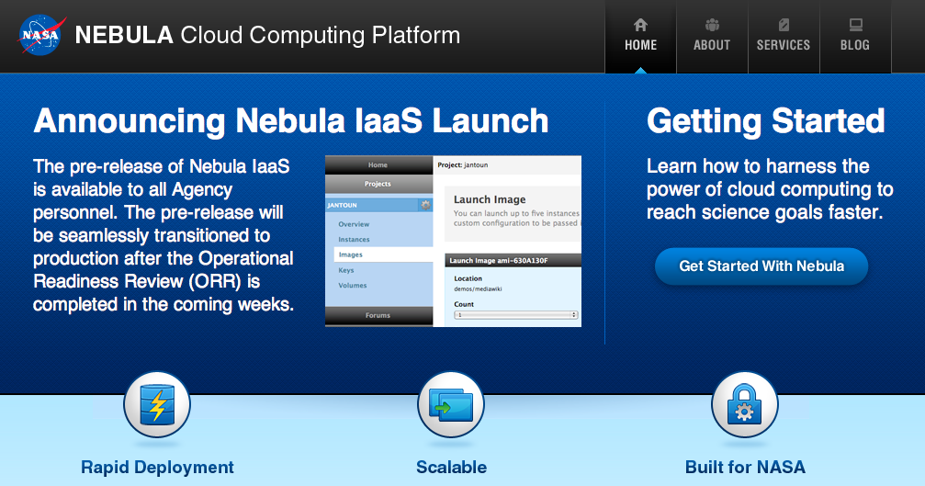
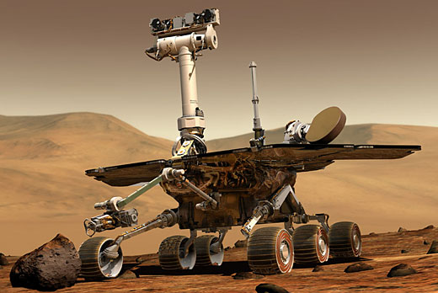
NASA
Science and websites

Slide 5
Batteries Included*
Strings
Data Types
Math
File and Directory Access
Data Persistence
Data Compression
File Formats
Logging
Specific OS Services
Interprocess Communication
Internet Data
Internet Protocols
Structured Markup
Multimedia
Internationalization
Testing
*These are categories - not libraries!

Slide 6

Your comments...
Python can handle gigantic scope efforts

Slide 7
Easy to learn
from datetime import datetime
name = “Daniel Greenfeld”
started_python = datetime(2005, 11, 1)
if name.startswith(“Daniel”):
  print(name)
for i in range(10):
  print(i)

Slide 8
Easy to learn
Daniel Greenfeld
0
1
2
3
4
5
6
7
8
9

Slide 9
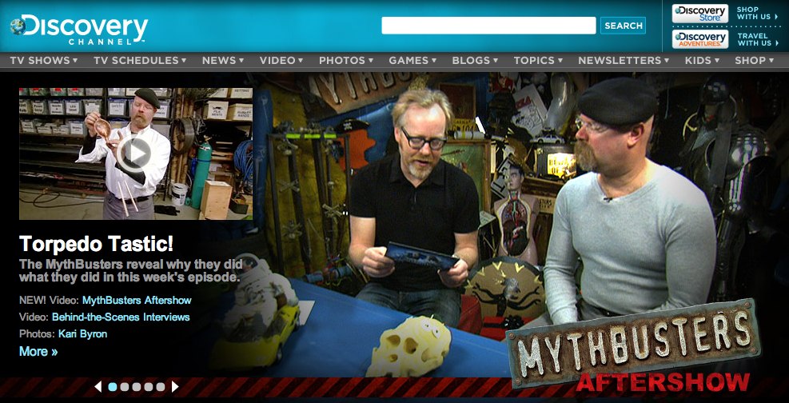
Powers the high profile

Slide 10
Buzzword Compliant
Object oriented
Functional
Procedural
Multiple Inheritance
Interfaces
Duck-typing

Slide 11
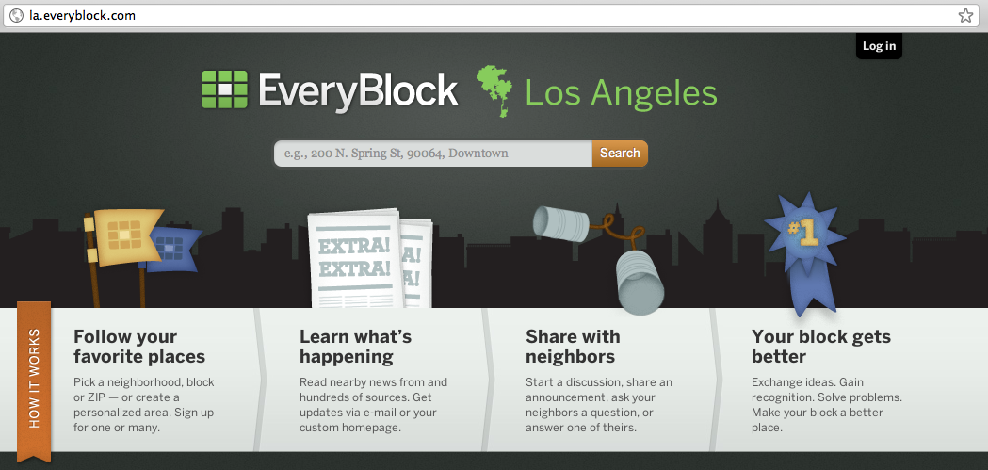
In our neighborhood

Slide 12
Speed
Development?
Performance?

Slide 13
Anecdotal Development speed
“I code about 5x faster in Python than in Java.”
-me

Slide 14
YMMV
Development speed
Less boilerplate
Straightforward syntax
Whitespace defines blocks

Slide 15
Performance Metrics
Benchmarks are as
accurate as elections...
but...
Python is one of the faster
dynamic languages. Comparable
to Perl and Ruby.

Slide 16
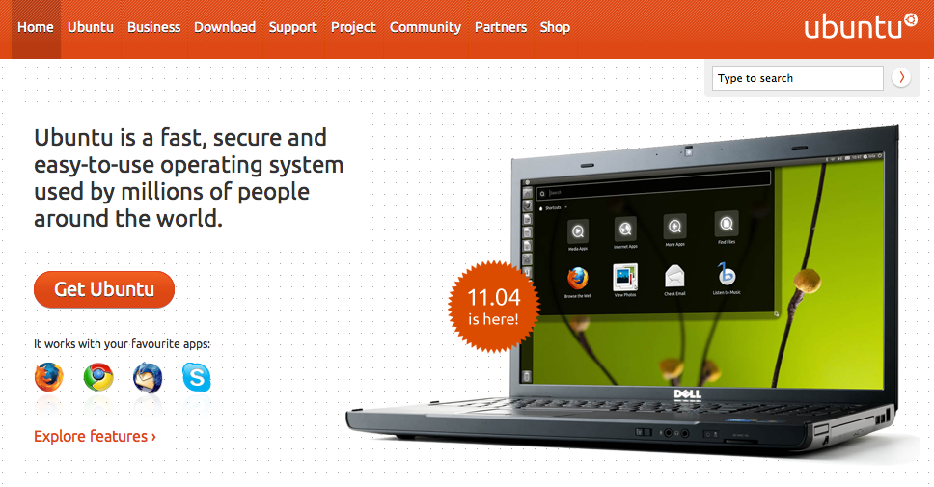
Ubuntu
Canonical

Slide 17
Package management
http://pypi.python.org
http://djangopackages.com

Slide 18
Web Frameworks
Django
Pyramid
Flask
... or write your own!

Slide 19
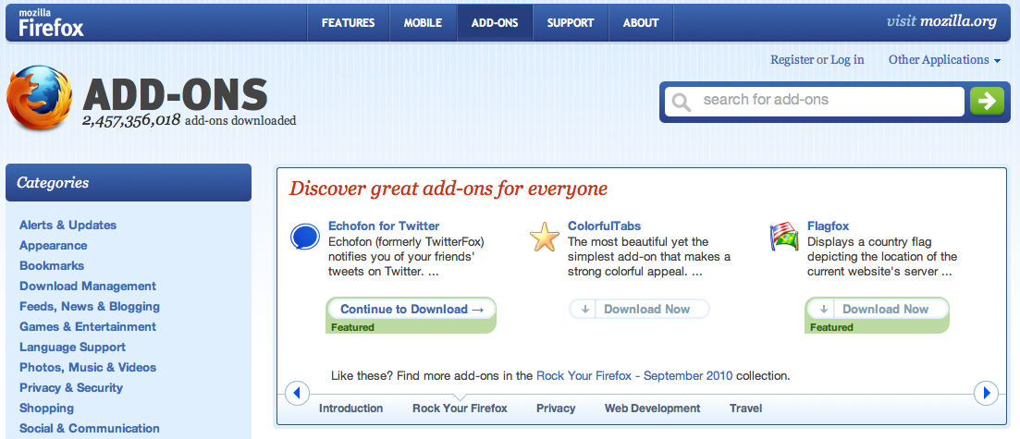
Mozilla.org from PHP to Django
cut the source from 44K to 12K loc

Slide 20
More features
Simplified memory management
Name Spaces
Monty Python humor

Slide 21

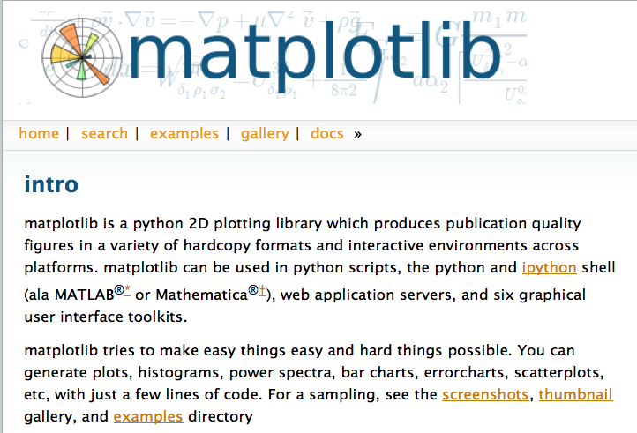
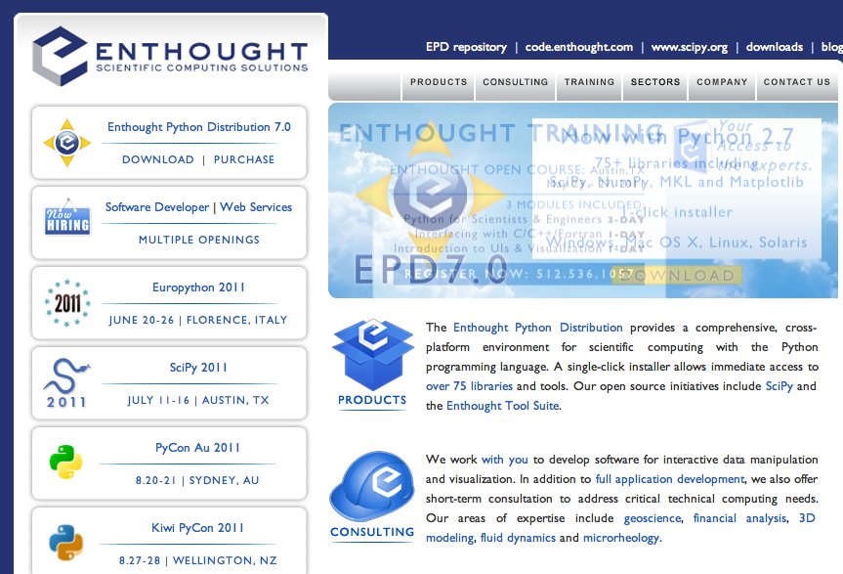
Science? Math?

Slide 22
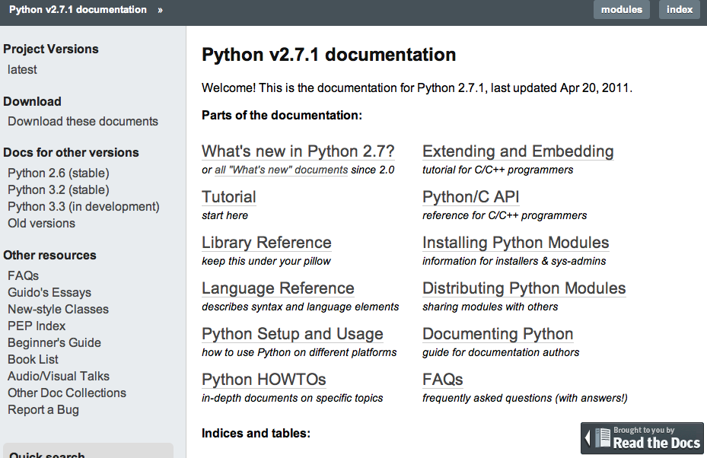
Culture of Documentation

Slide 23
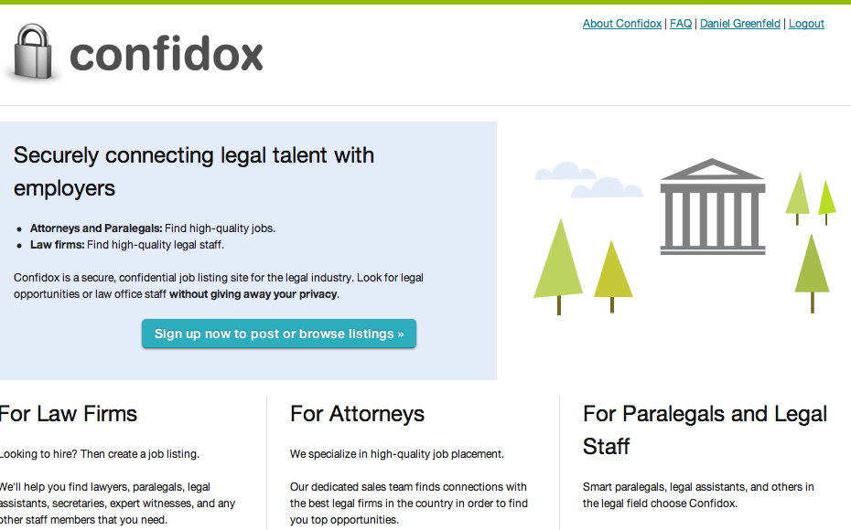
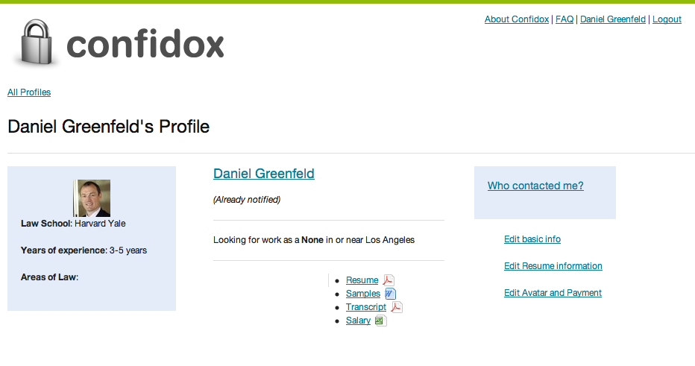
Python gave us a win

Slide 24
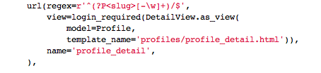
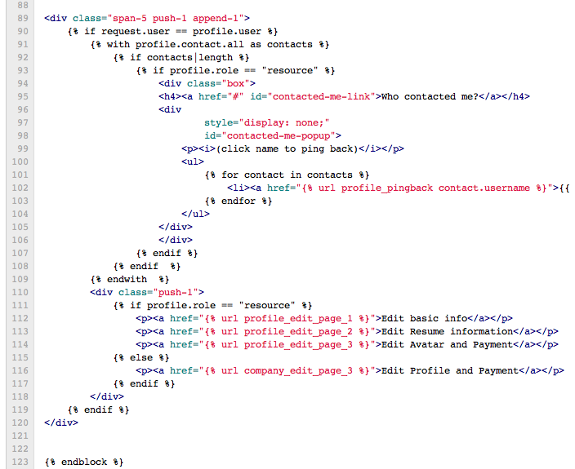
Python gave us a win

Slide 25
Zen of Python
>>> import thisThe Zen of Python, by Tim PetersBeautiful is better than ugly.Explicit is better than implicit.Simple is better than complex.Complex is better than complicated.Flat is better than nested.Sparse is better than dense.Readability counts.Special cases aren't special enough to break the rules.Although practicality beats purity.Errors should never pass silently.Unless explicitly silenced.In the face of ambiguity, refuse the temptation to guess.There should be one-- and preferably only one --obvious way to do it.Although that way may not be obvious at first unless you're Dutch.Now is better than never.Although never is often better than *right* now.If the implementation is hard to explain, it's a bad idea.If the implementation is easy to explain, it may be a good idea.Namespaces are one honking great idea -- let's do more of those!

Slide 26
Zen of Python
>>> import thisThe Zen of Python, by Tim PetersBeautiful is better than ugly.Explicit is better than implicit.Simple is better than complex.Complex is better than complicated.Flat is better than nested.Sparse is better than dense.Readability counts.Special cases aren't special enough to break the rules.Although practicality beats purity.Errors should never pass silently.Unless explicitly silenced.In the face of ambiguity, refuse the temptation to guess.There should be one-- and preferably only one --obvious way to do it.Although that way may not be obvious at first unless you're Dutch.Now is better than never.Although never is often better than *right* now.If the implementation is hard to explain, it's a bad idea.If the implementation is easy to explain, it may be a good idea.Namespaces are one honking great idea -- let's do more of those!

Slide 27
Python Jobs are plentiful!

